Slide 1
EDA
Unveiling Ride Patterns!
Every ride has a story
By Omar Mamon

Slide 2
CONTENTS OF THIS TEMPLATE
Data Structure
Handling Invalid Values
Handling Outliers
Feature Engineering
Data Insights

Slide 3
Data Structure
01
Features Overview

Slide 4
Understanding the Features in Our Data
Features Overview
Our dataset consists of 500,000 records and 26 columns.
User ID: Unique identifier for each user.
User Name: The name of the passenger.
Driver Name: The name of the driver.
Car Condition: The car's condition (Bad, Good, Excellent, etc.).
Weather: Weather during the ride (Cloudy, Rainy, Sunny, etc.).
Traffic Condition: Traffic situation during the ride (Congested, Flow, or Dense).
Key: Unique identifier for each ride.
Fare Amount: The trip fare in dollars.
Pickup Datetime: Timestamp of when the ride was requested.
Pickup Longitude: Longitude of the pickup location.
Pickup Latitude: Latitude of the pickup location.
Drop-off Longitude: Longitude of the drop-off location.
Drop-off Latitude: Latitude of the drop-off location.

Slide 5
Understanding the Features in Our Data
Features Overview
Our dataset consists of 500,000 records and 26 columns.
Passenger Count: Number of passengers during the trip.
Hour: Hour when the ride was requested.
Day: Day of the month when the ride was requested.
Month: Month when the ride was requested.
Weekday: Day of the week (Monday, Tuesday, etc.).
Year: Year of the ride request.
JFK Distance: Distance between the pickup location and JFK Airport.
EWR Distance: Distance between the pickup location and Newark Airport.
LGA Distance: Distance between the pickup location and LaGuardia Airport.
SOL Distance: Distance between the pickup location and the Statue of Liberty.
NYC Distance: Distance between the pickup location and New York City center.
Ride Distance: Total trip distance.
Bearing: The ride's directional angle from start to end.

Slide 6
“Before diving deep into analysis, let's first peek under the hood to spot the strange, funny, and unexpected statistics hidden in our data.”

Slide 7
Understanding the Features in Our Data
Data Statistics Overview
:
Let's uncover some key insights and curious discoveries from the dataset:.
Missing Values ❌:
Found in dropoff coordinates, distances, and ride metrics.
Total of 5 missing values across several columns.
Impact Assessment 📉:
Missing data represents 0.001% of total records.
Rows can be safely deleted without significant data loss.

Slide 8
Understanding the Features in Our Data
Data Statistics Overview
:
Let's uncover some key insights and curious discoveries from the dataset:.
Outliers Detection 🔍:
Fare Amount: Ranges from -44.9$ (Is this a refund or a ghost ride? 👻💸)
to 500$ (Someone enjoyed a luxury ride! 💎🚖).
Drop-off Latitude & Longitude: Max values 7.06 , 0.71
Ride Distance: Maximum 12399.95 miles
Airport Distances hit 30,000 miles — NASA might be interested!

Slide 9
WHOA!
7.06 , 0.71 ?? Our rides are making waves ... Literally! 🌊🚖⛴️

Slide 10
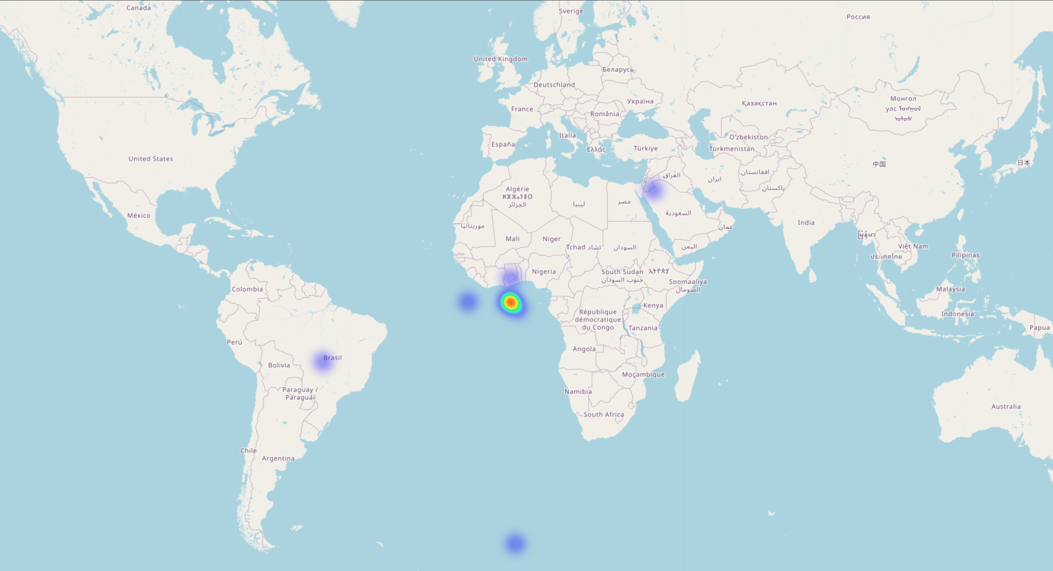
Pick Up A PICTURE IS WORTH A THOUSAND WORDS

Slide 11
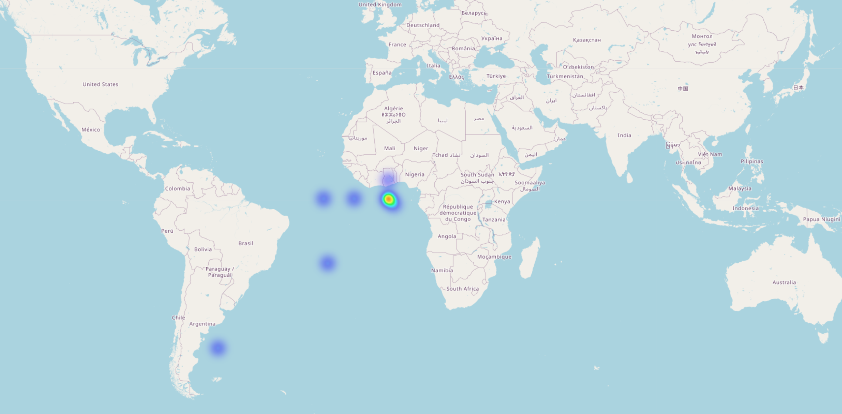
Drop Down ! A PICTURE IS WORTH A THOUSAND WORDS

Slide 12
500,000
Invalid entries for longitude and latitude

Slide 13
02
Handling Invalid Values
Let’s rescue our rides from their unexpected oceanic adventures!

Slide 14
Invalid Values Handling
The data check exposed 100% invalid entries caused by unrealistic longitude and latitude coordinates
The following columns were affected and dropped entirely:
Pickup longitude
Pickup latitude
Dropoff longitude
Dropoff latitude
The dataset is now clean and ready for outlier detection!

Slide 15
Handling Outliers
03
Sometimes data likes to break the rules

Slide 16
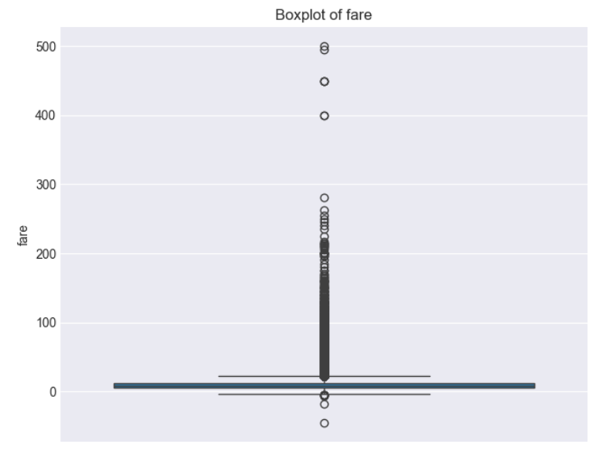
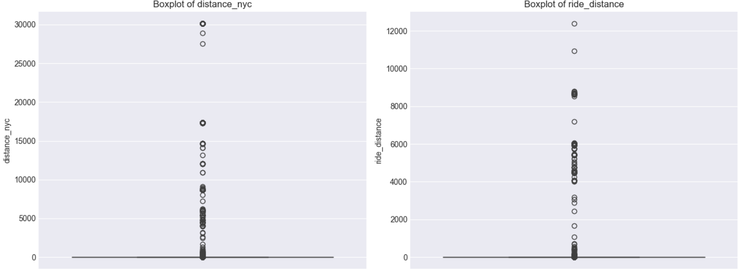
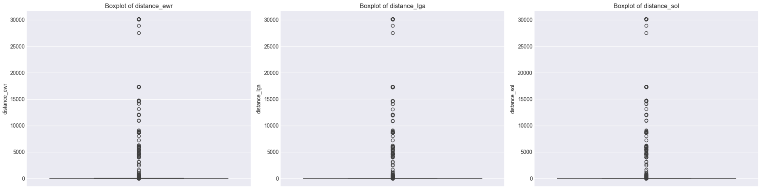
THESE ARE OUTLIERS!
Time to refine the data

Slide 17
01
02
03
LOCATIONS
RIDE DISTANCE
FARE

Slide 18
01 LOCATIONS

Slide 19
01 LOCATIONS
Outlier detection focused on location-based distances revealed 10,280 anomalous records (2.06%) across key distance columns:
Distance to JFK Airport
Distance to EWR Airport
Distance to LGA Airport
Distance to Statue of Liberty
Distance to NYC Center
These records were removed to ensure data consistency and accuracy, reducing the dataset size to 489,715 entries.

Slide 20
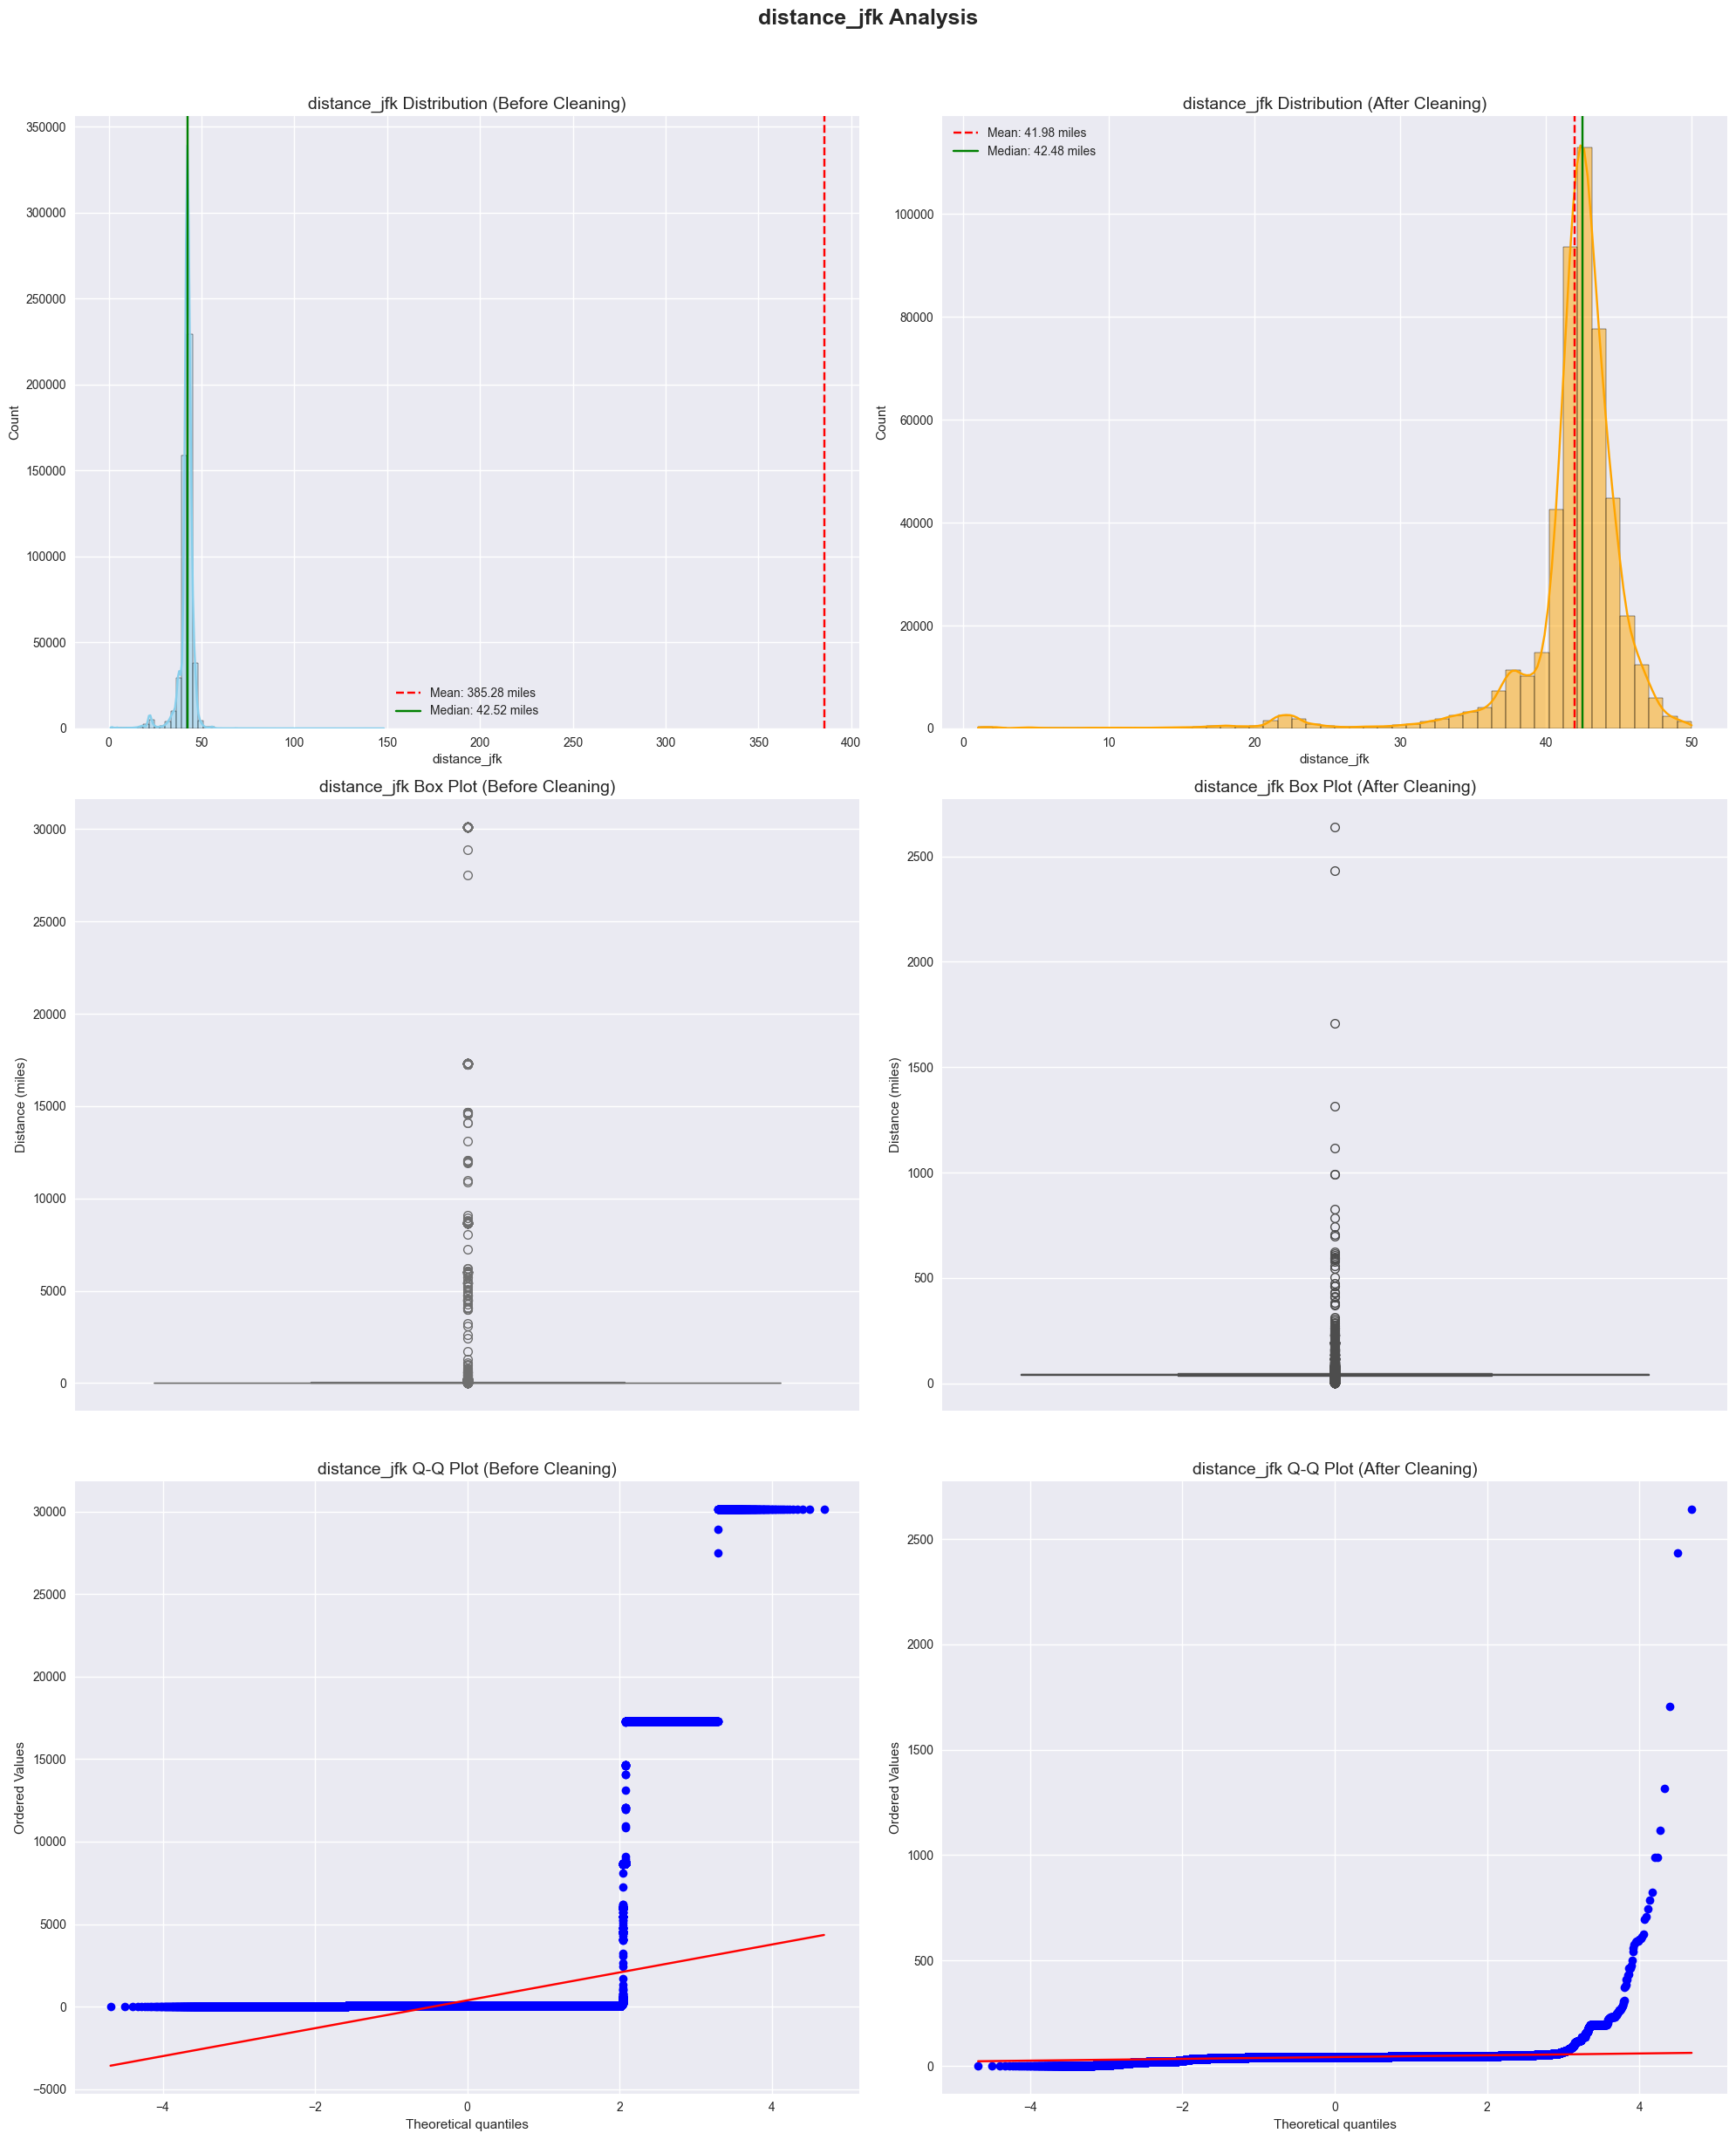
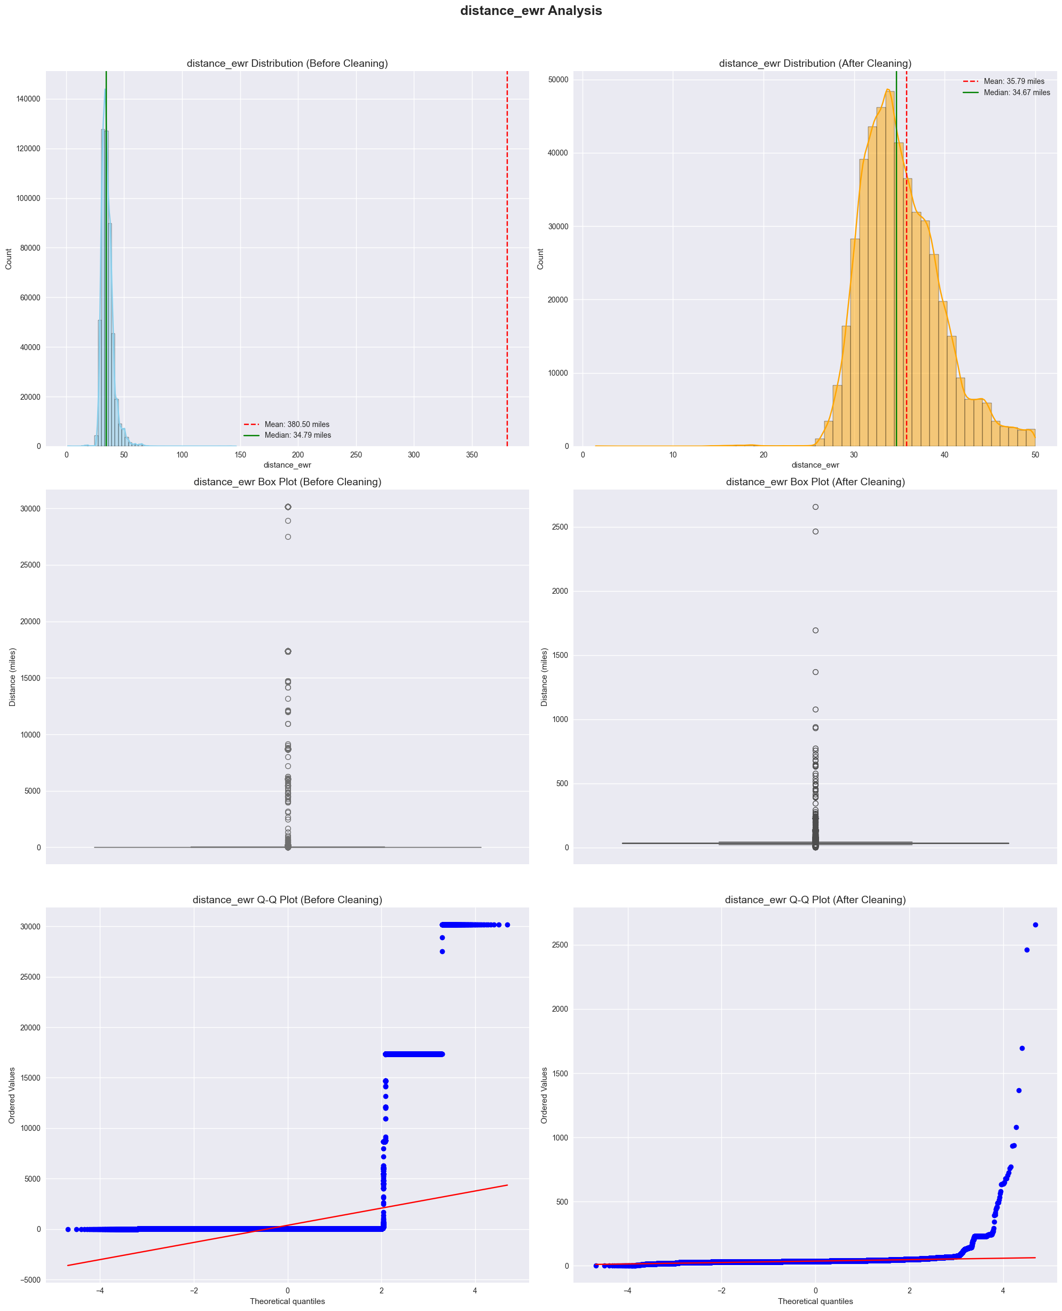
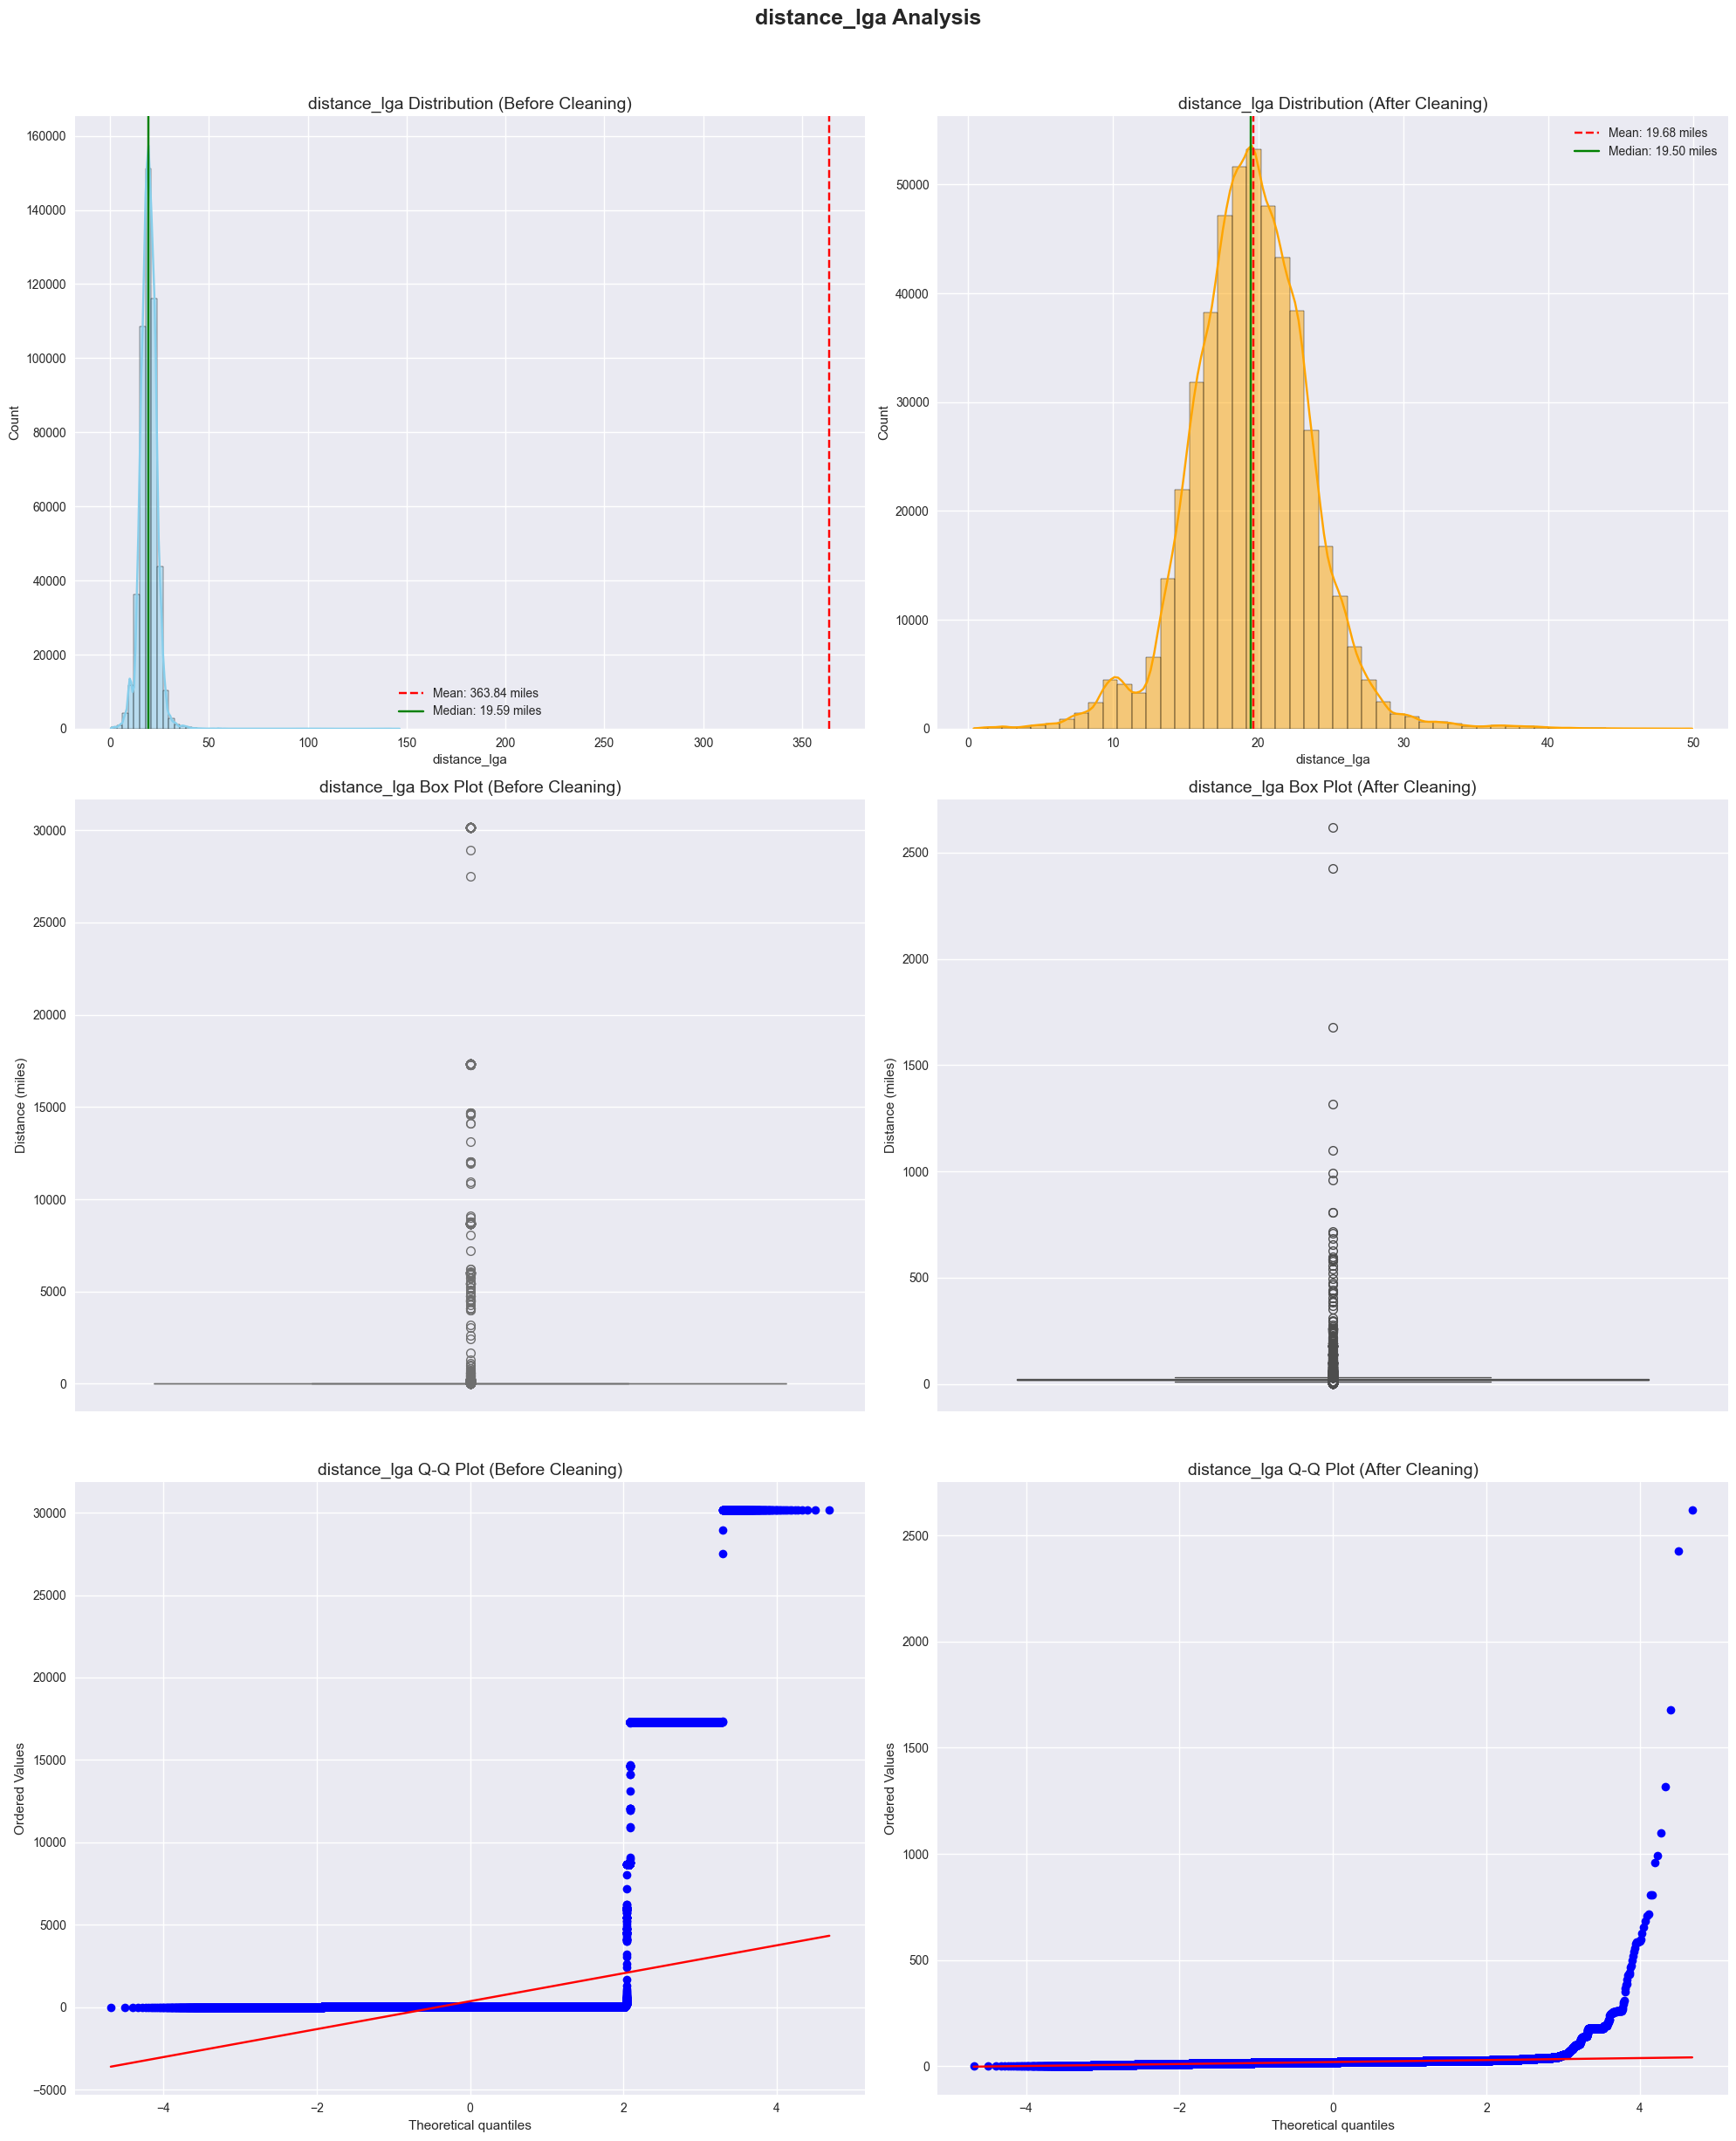
01 LOCATIONS

Slide 21
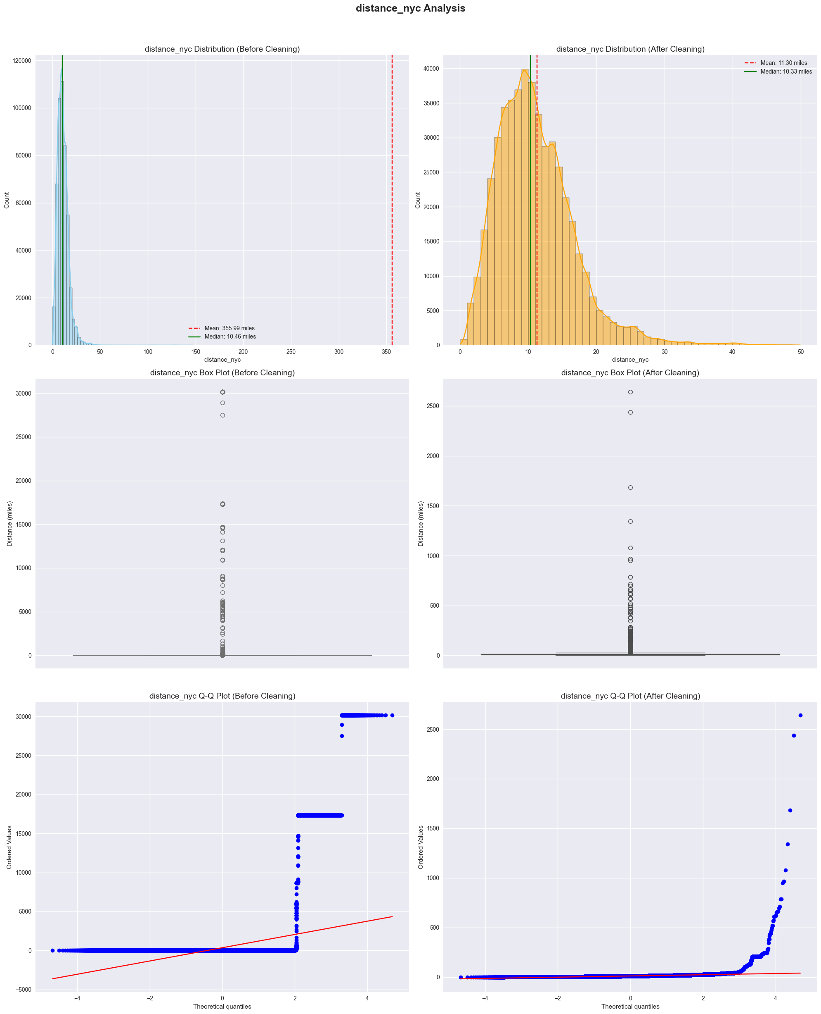
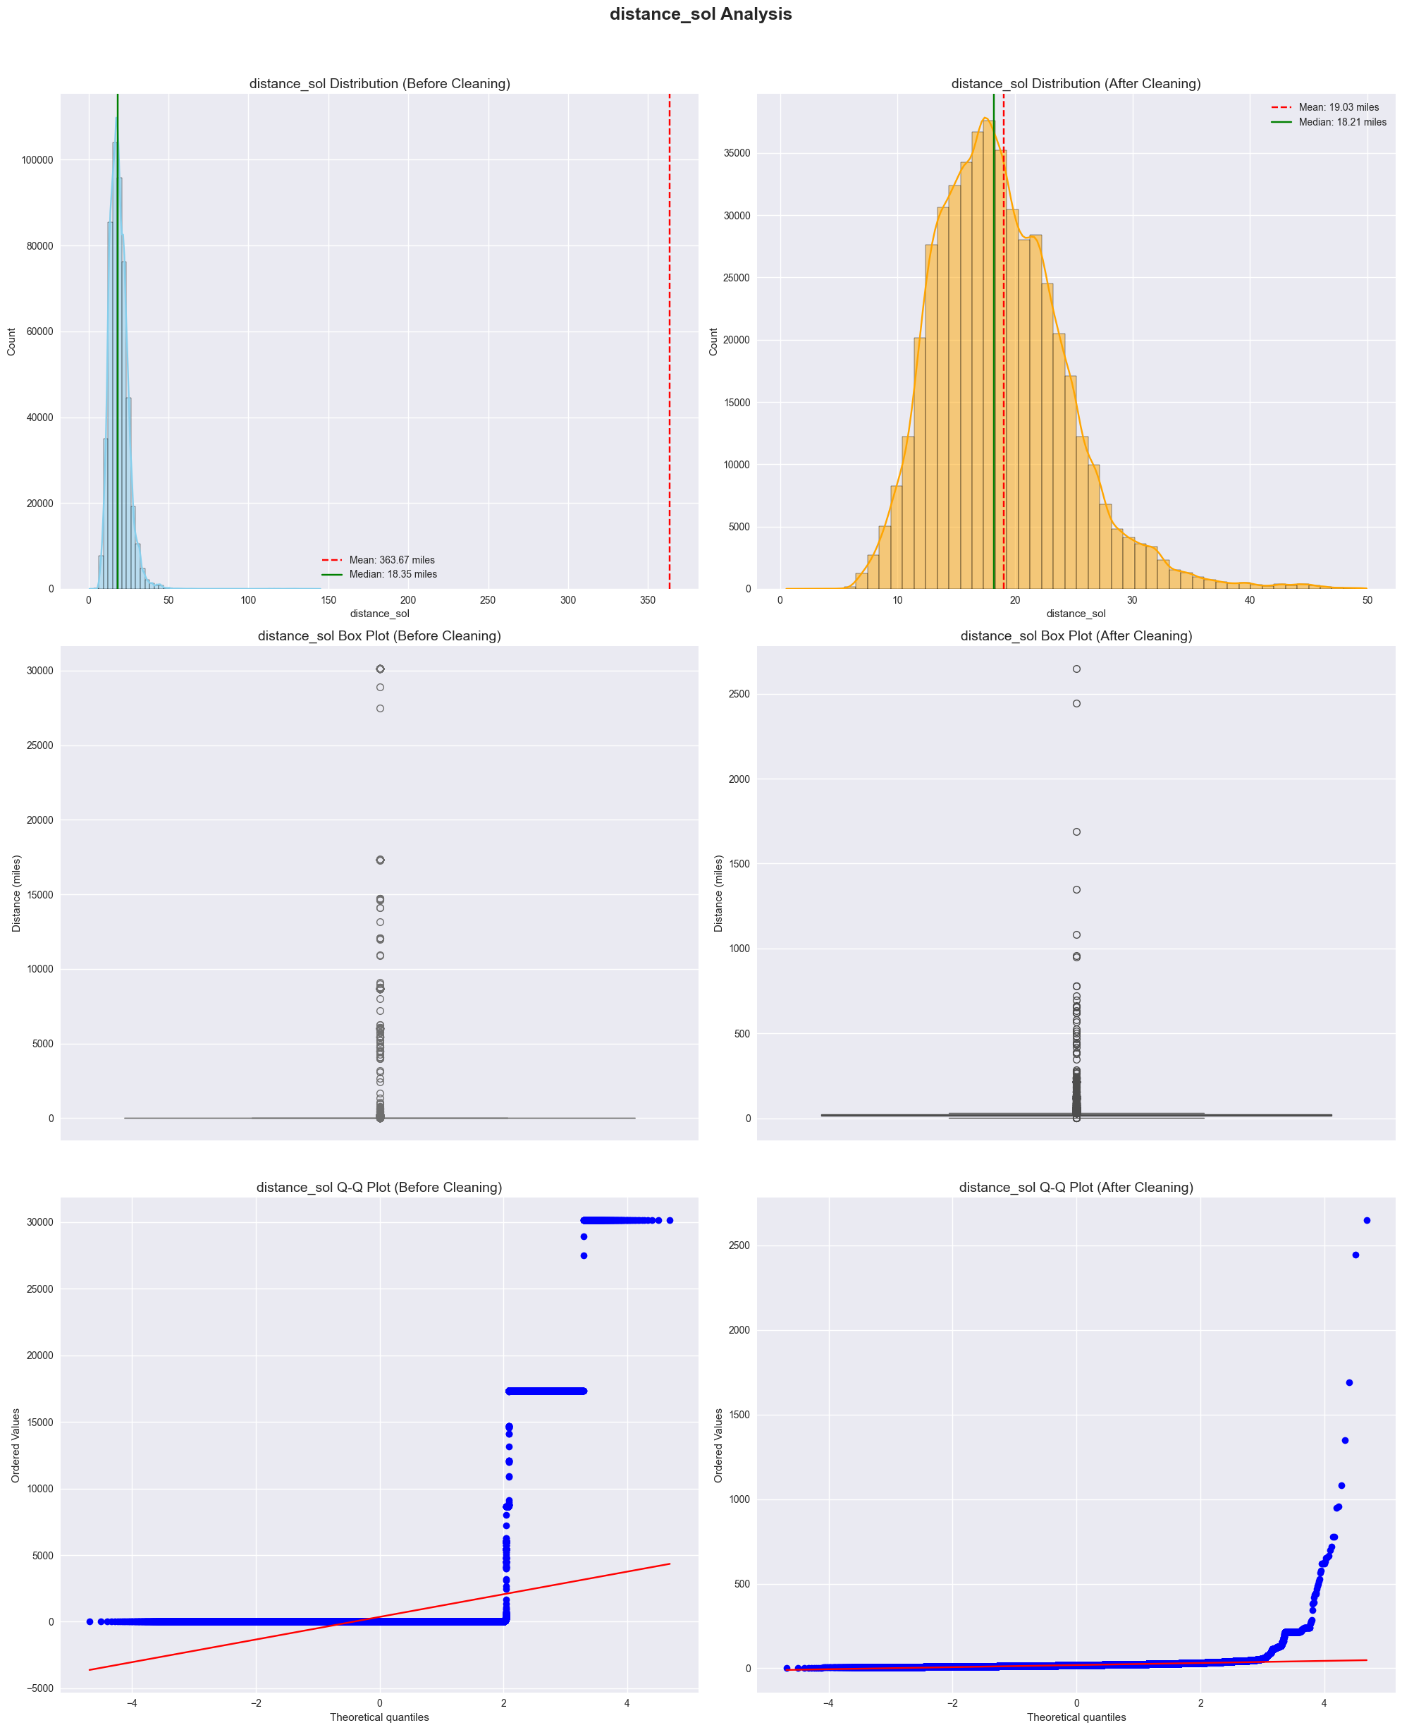
01 LOCATIONS

Slide 22
02 RIDE DISTANCE
Outlier detection on Ride Distance applied a threshold between 0.1 miles (minimum realistic trip) and 200 miles (maximum reasonable trip, covering a state or more).
This filtering ensured removing extreme values while preserving the integrity of the dataset.

Slide 23
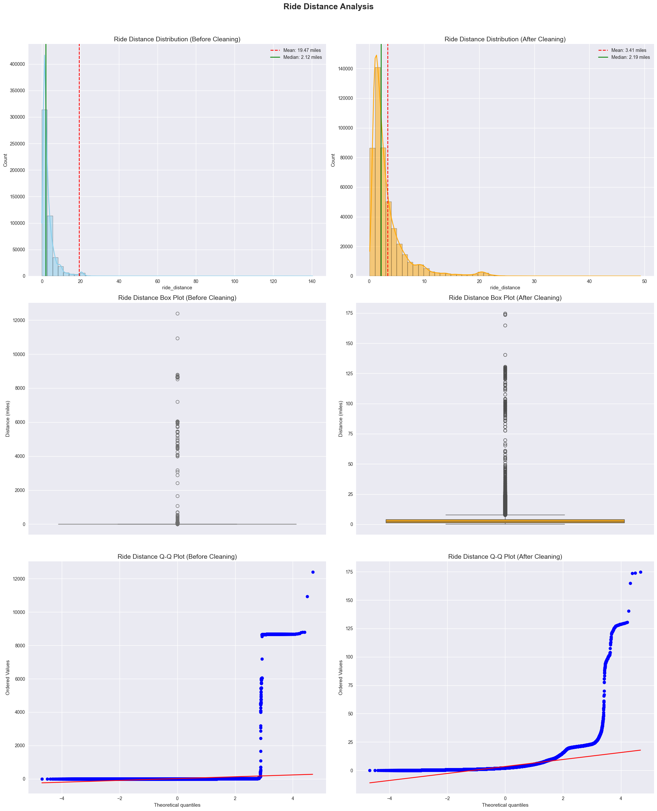
02 RIDE DISTANCE

Slide 24
03 Fare
Outlier Detection: Applied IQR method to detect anomalous fares.
Replacement Strategy: Outliers were corrected using the median fare per mile from trips with similar distance, time of day, and weekend status.
Capping Boundaries: Capped fares to a maximum of 200$ and a minimum of 2.5$.
Log Transformation: Performed log transformation to normalize fare distribution and mitigate the impact of extreme values.

Slide 25
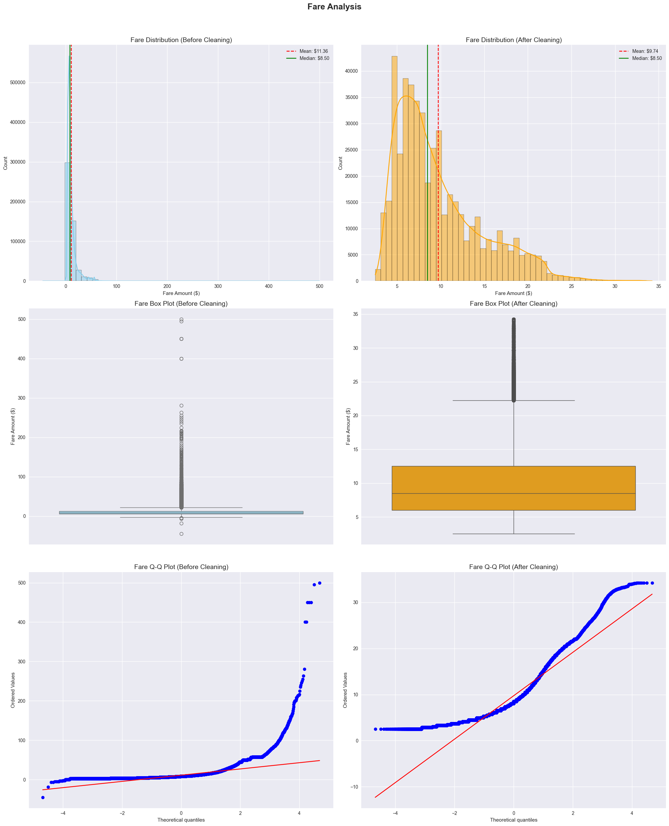
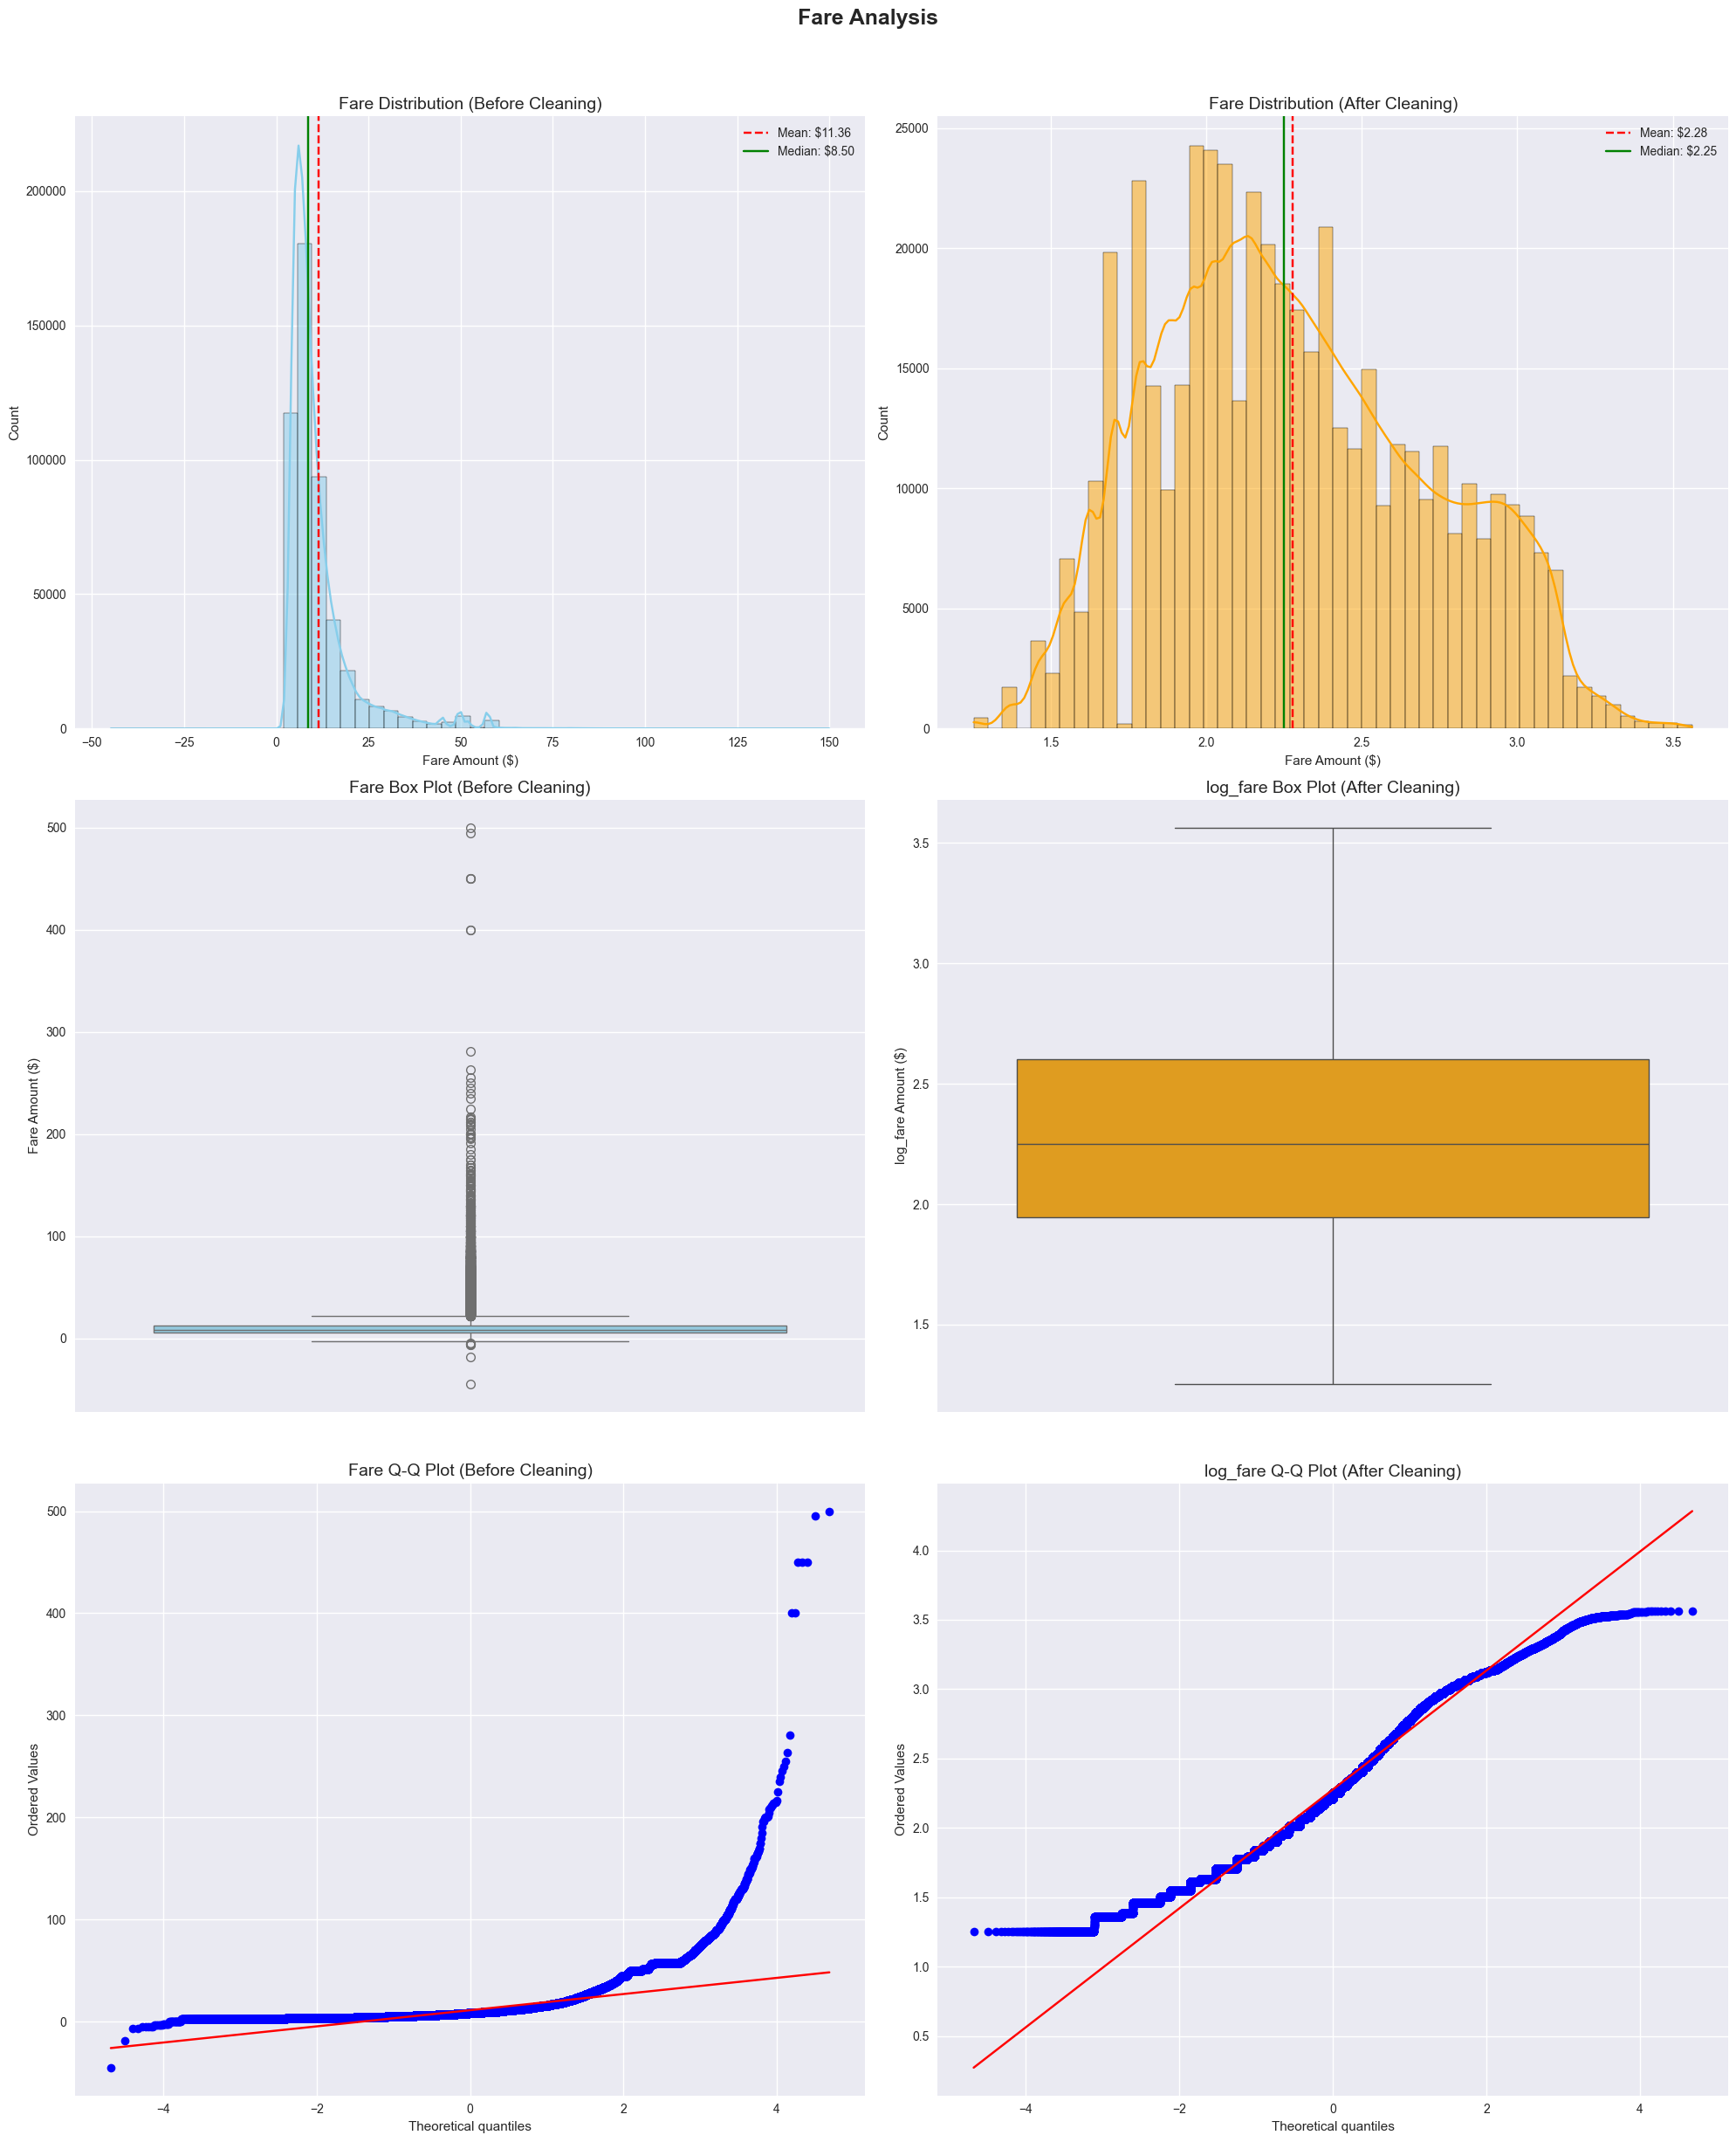
03 Fare

Slide 26
04
Feature Engineering
Unlocking New Insights

Slide 27
Feature Engineering – New Features
New features were crafted to enrich the dataset and extract deeper insights:
Temporal Features:
Pickup hour, minute, day of the week, month, year, day of the year, and quarter.
Time of day categories (Night, Morning, Afternoon, Evening).
Rush hour and weekend flags.
Distance Features:
Distance bins to group trips by length.
Price per mile calculation.
Directional Feature:
Ride bearing transformed into categorical compass directions.

Slide 28
Feature Engineering – Categorical Encoding
To prepare categorical data for machine learning models, various encoding techniques were applied:
Ordinal Encoding
Applied to features with a natural order.
Examples:
Car Condition: Quality levels ranked from Bad to Excellent.
Traffic: Flow, Dense, Congested representing increasing severity.
Distance Bin: Grouped distance ranges from shortest to longest

Slide 29
Feature Engineering – Categorical Encoding
One-Hot Encoding
Used for unordered categories where each category is equally distinct.
Example:
Weather: Each weather condition represented as a separate binary column.
Cyclical Encoding
Essential for circular features to maintain continuity between start and end values.
Examples:
Time of Day: Captures daily patterns.
Direction: Encodes compass directions.
Request Weekday: Preserves the cyclic nature of the week

Slide 30
Data Insights
05
Discovering Data Stories

Slide 31
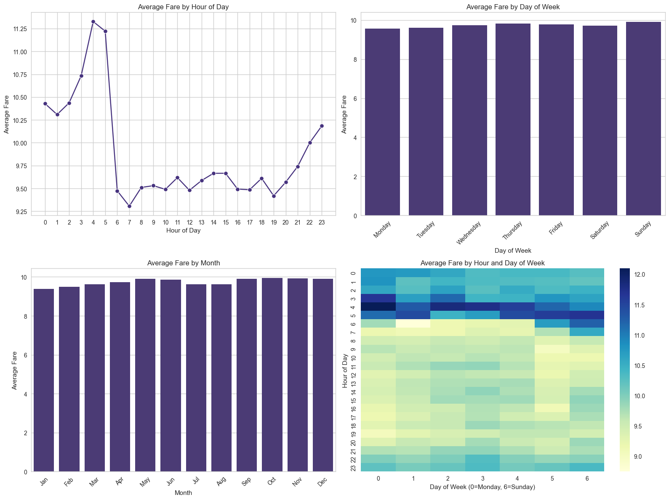
Data Insights

Slide 32
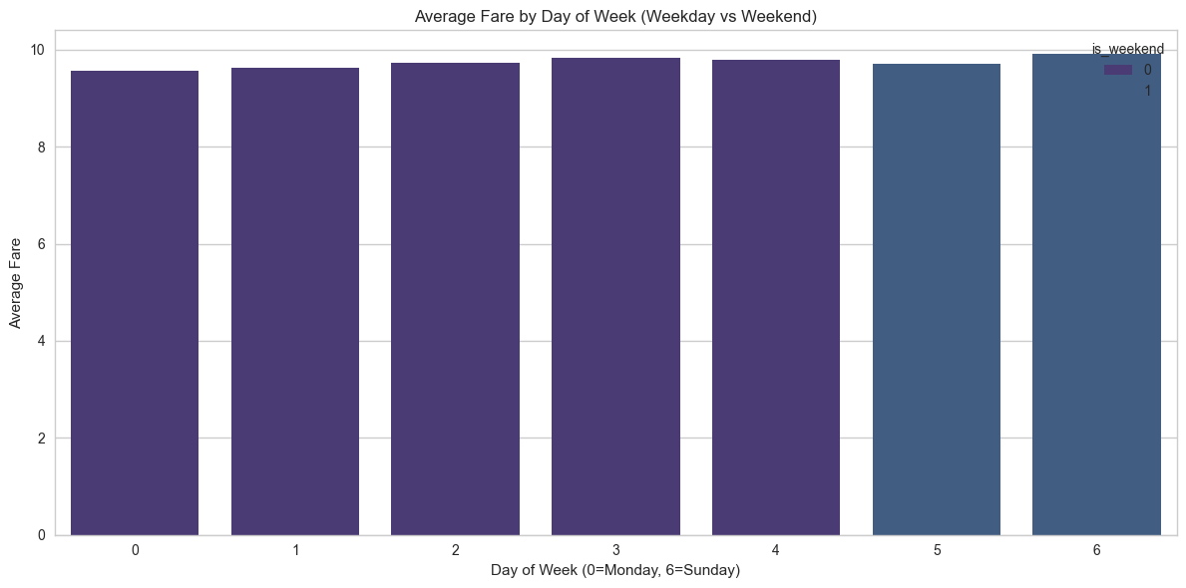
Data Insights

Slide 33
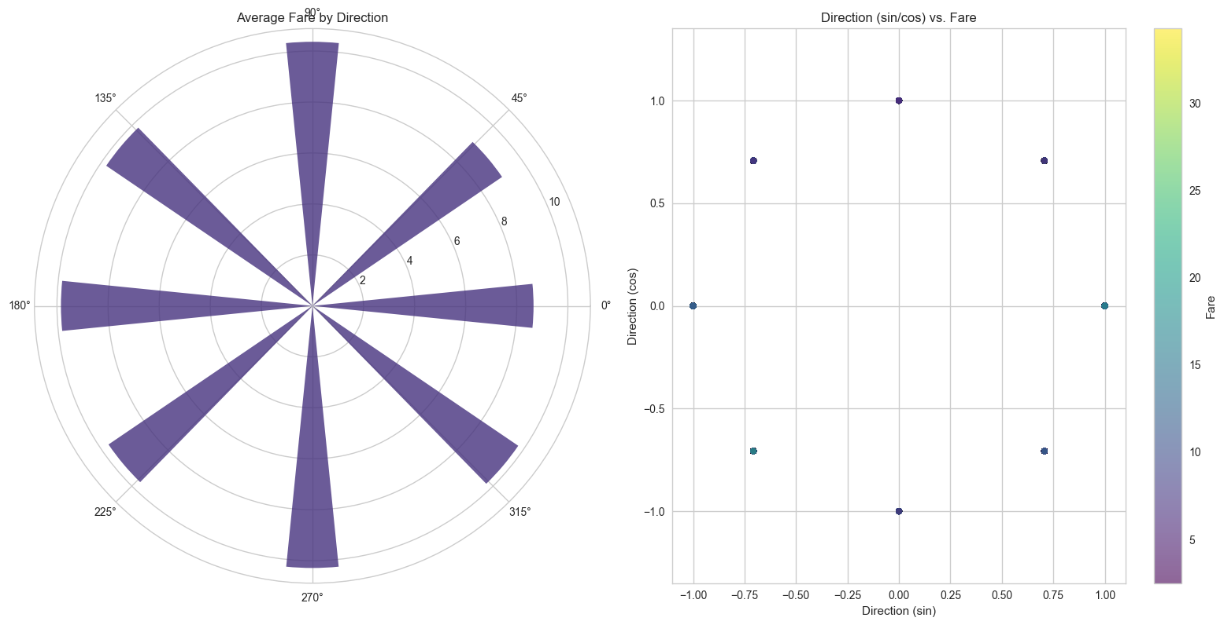
Data Insights

Slide 34
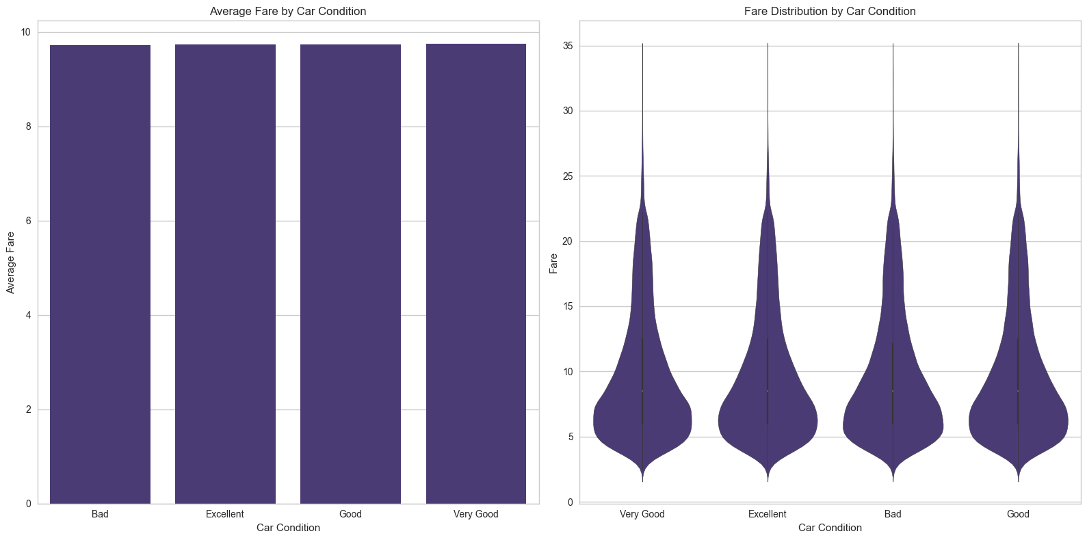
Data Insights

Slide 35
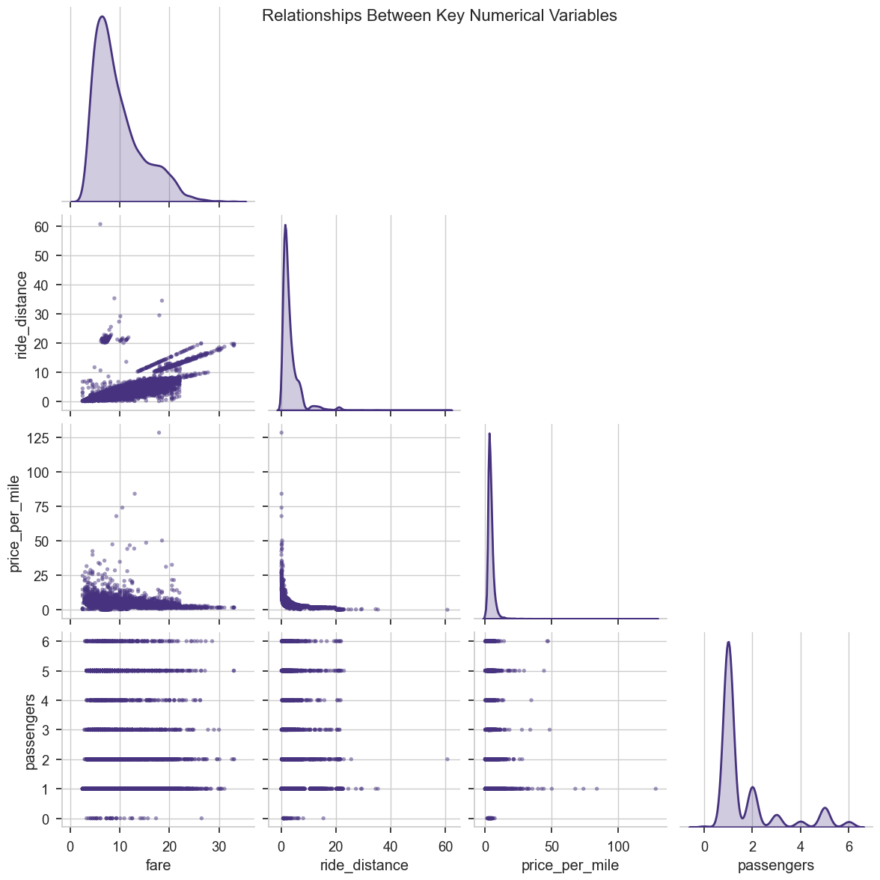
Data Insights

Slide 36
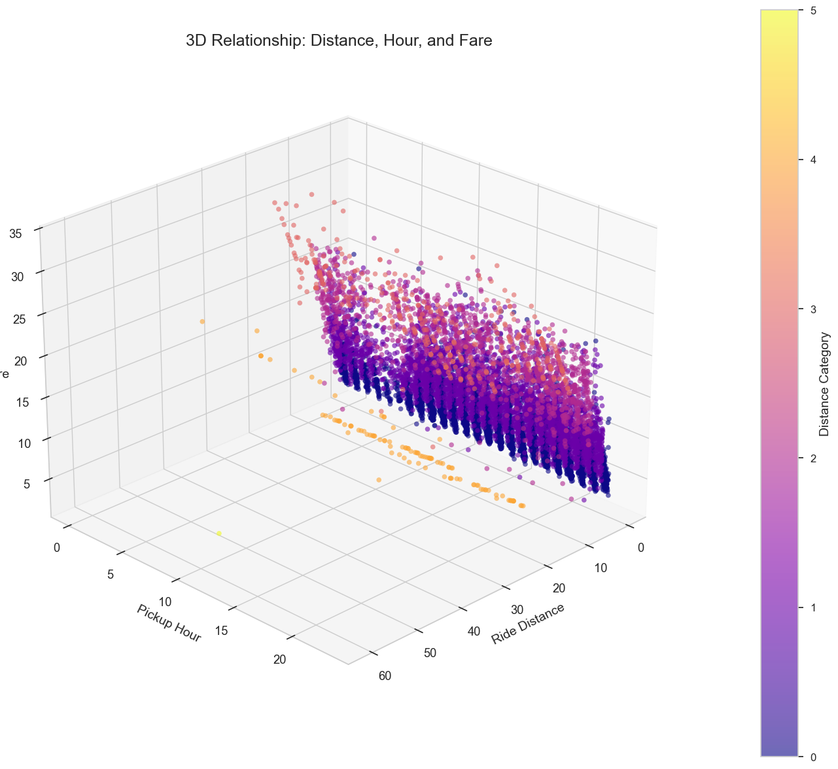
Data Insights

Slide 37
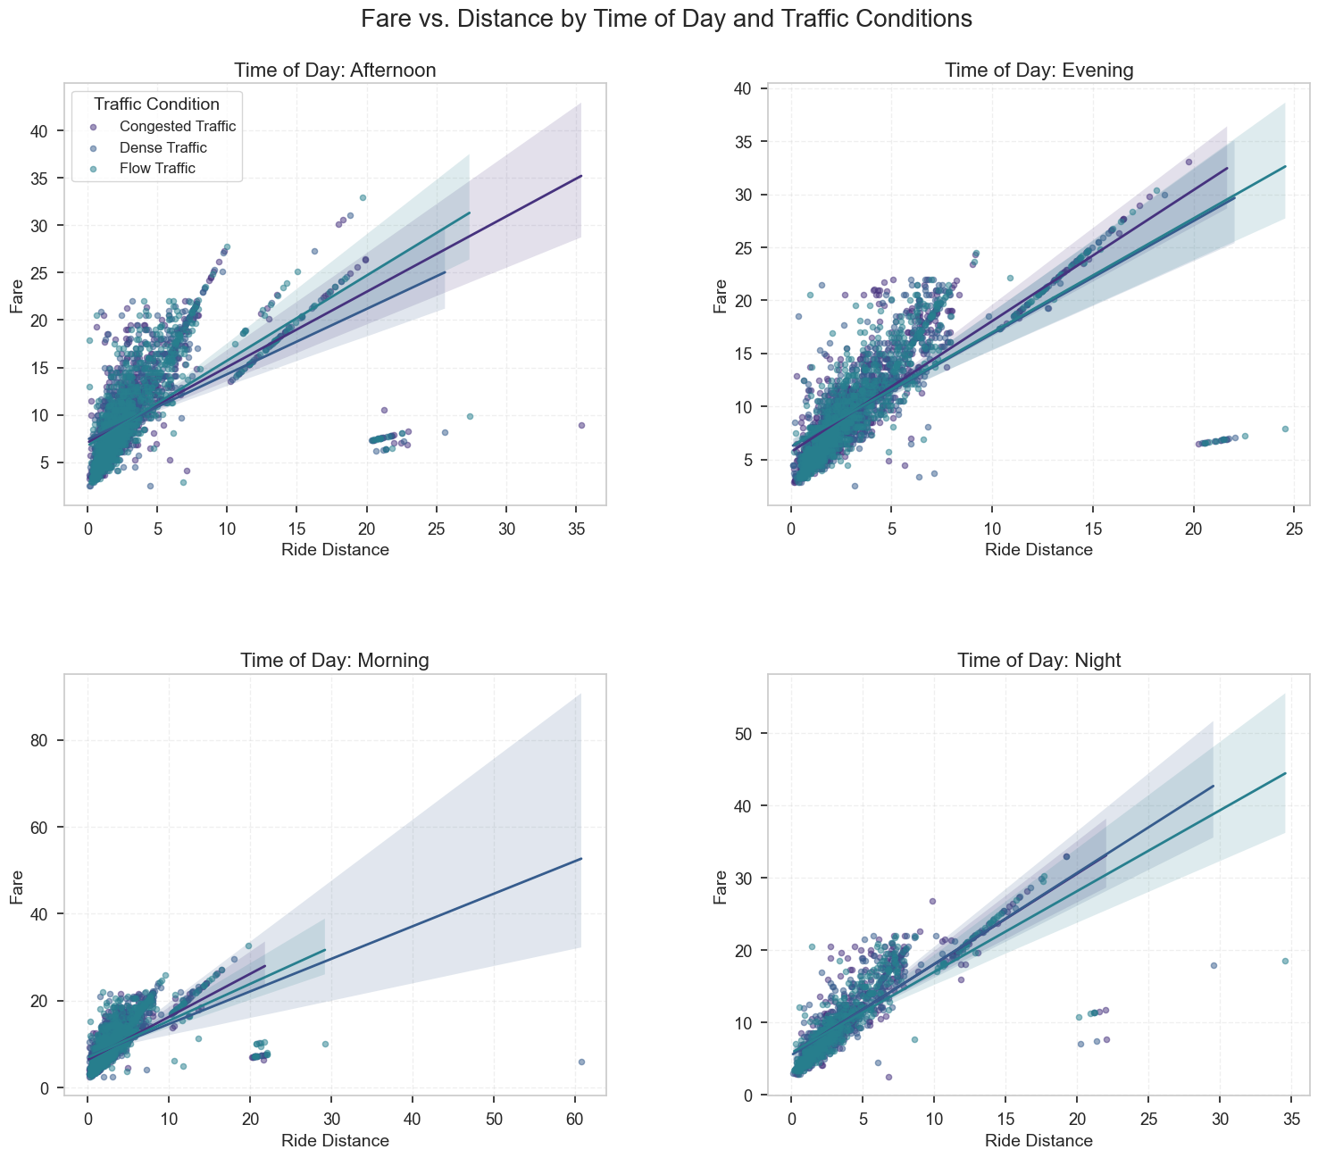
Data Insights

Slide 38
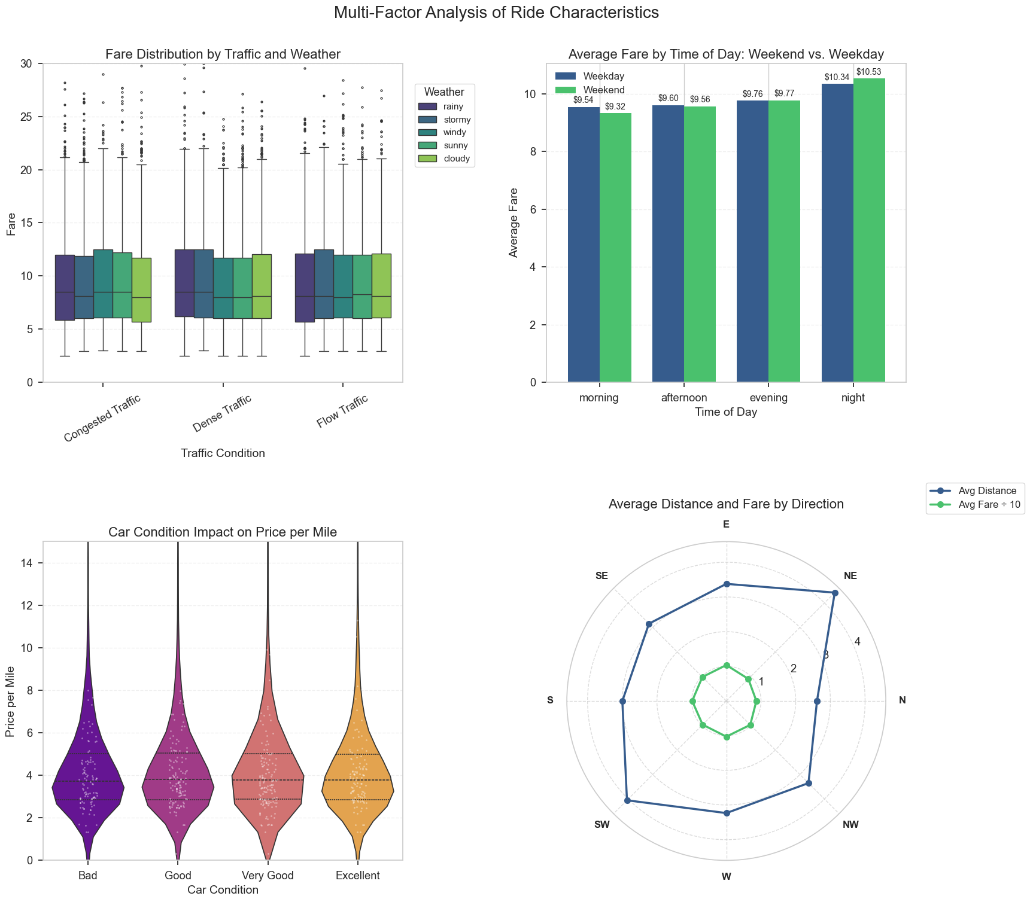
Data Insights

Slide 39
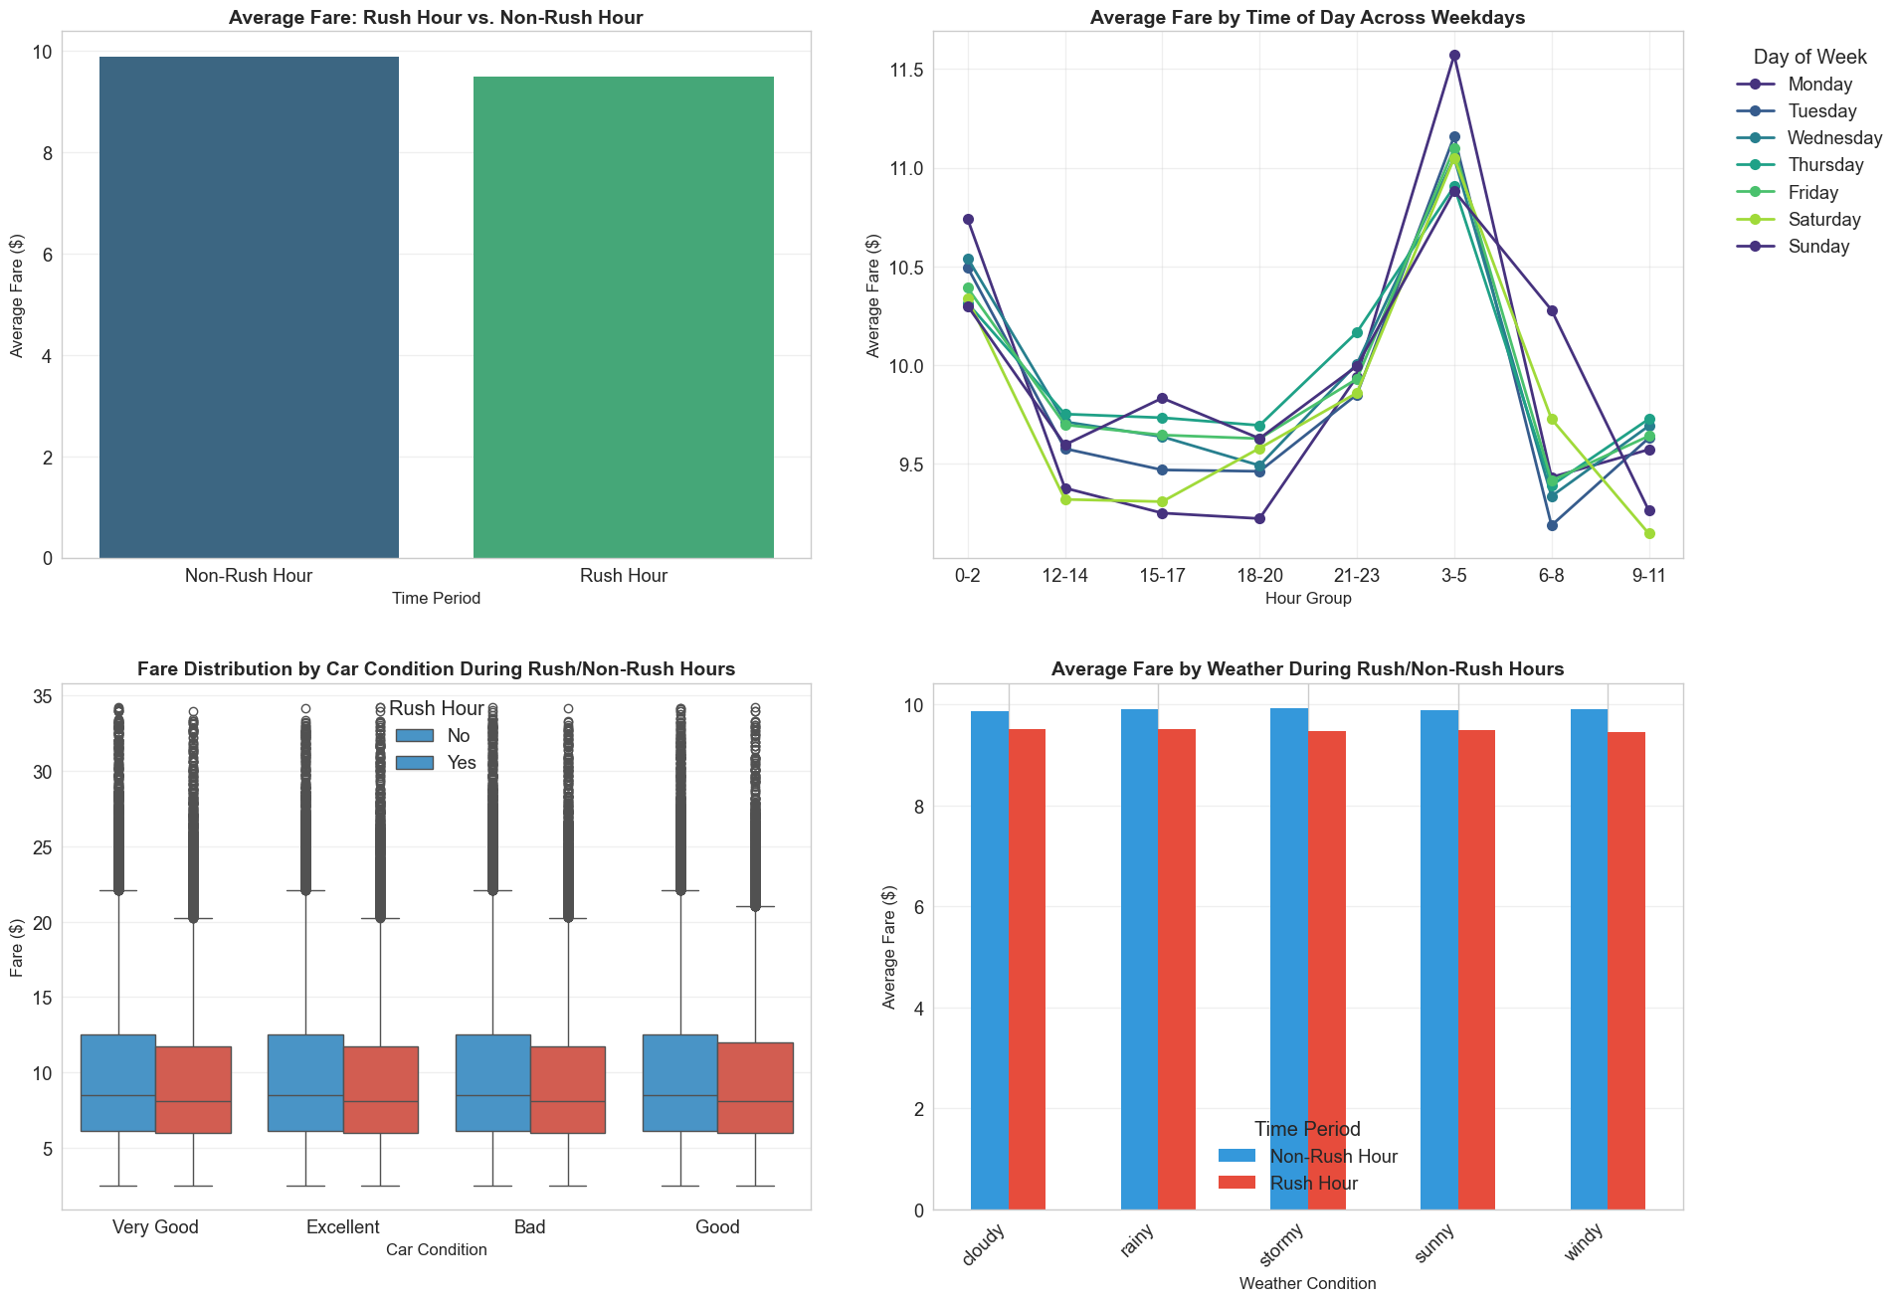
Data Insights

Slide 40
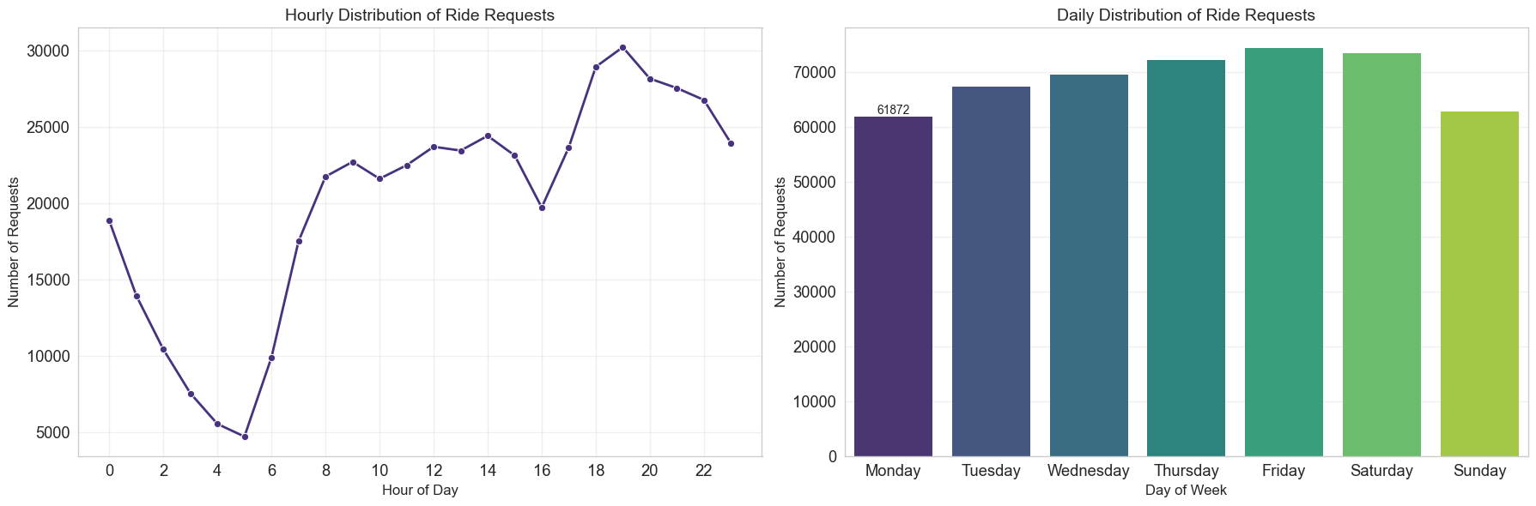
Data Insights

Slide 41
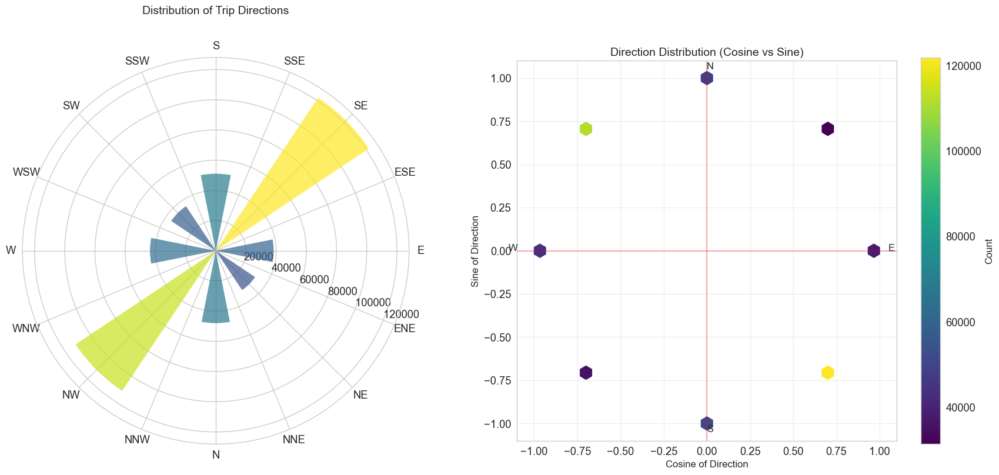
Data Insights

Slide 42
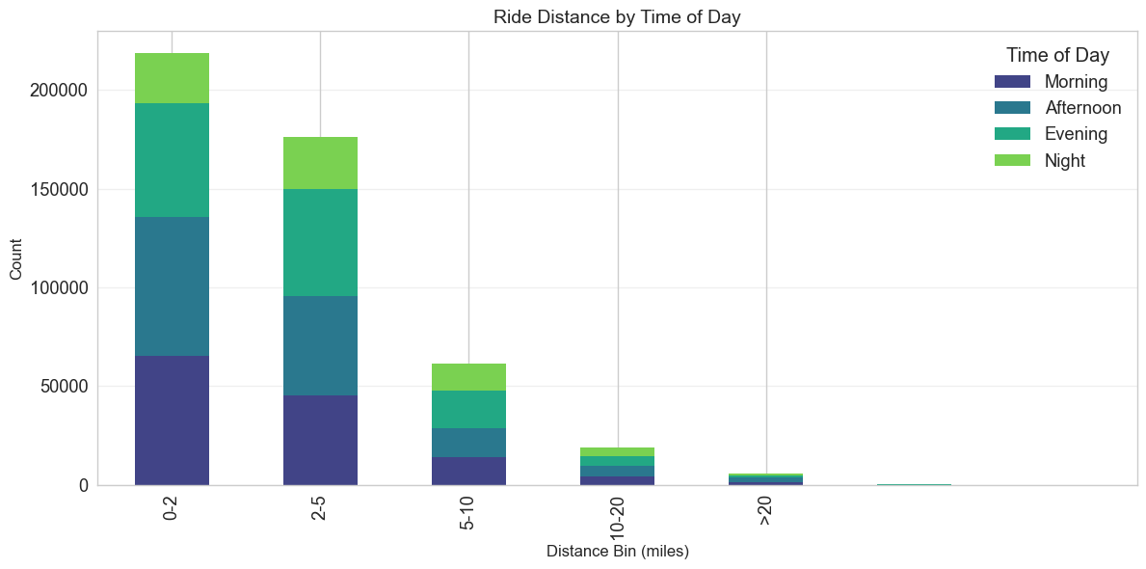
Data Insights

Slide 43
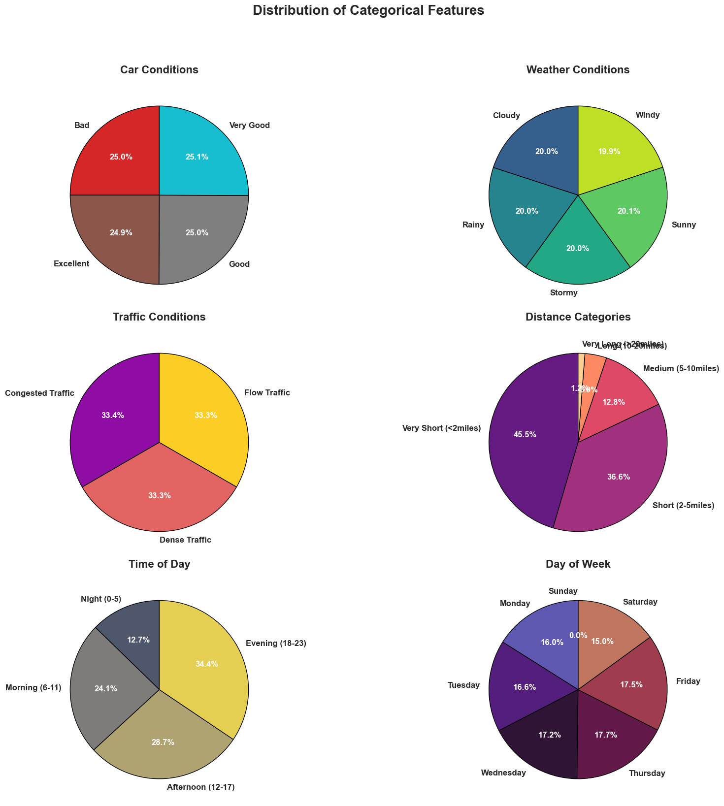
Data Insights

Slide 44
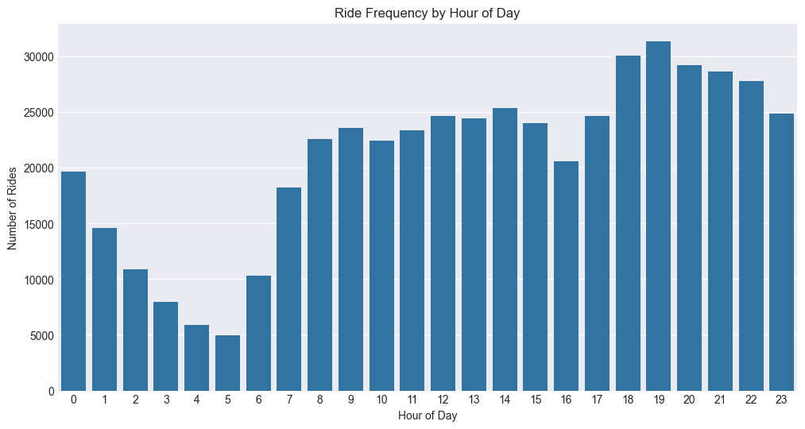
Data Insights

Slide 45
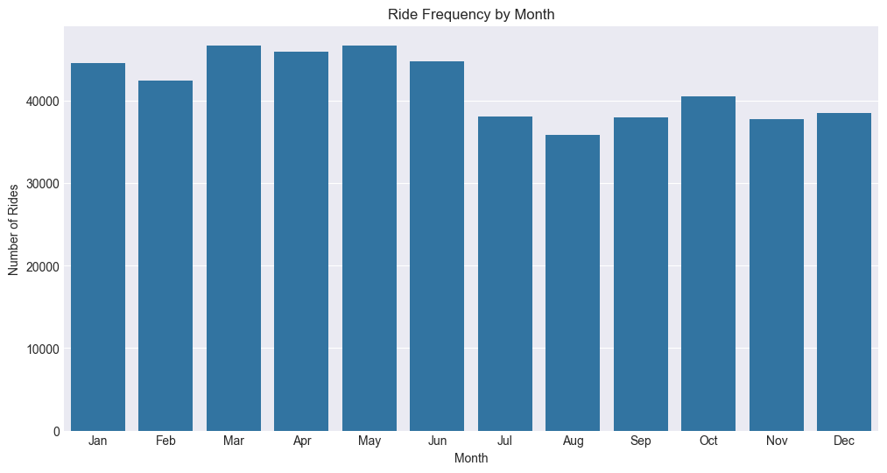
Data Insights

Slide 46
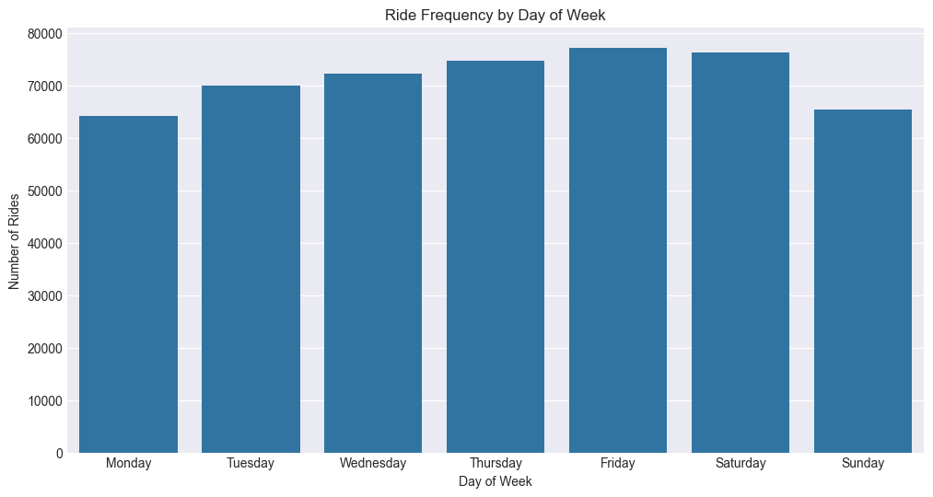
Data Insights

Slide 47
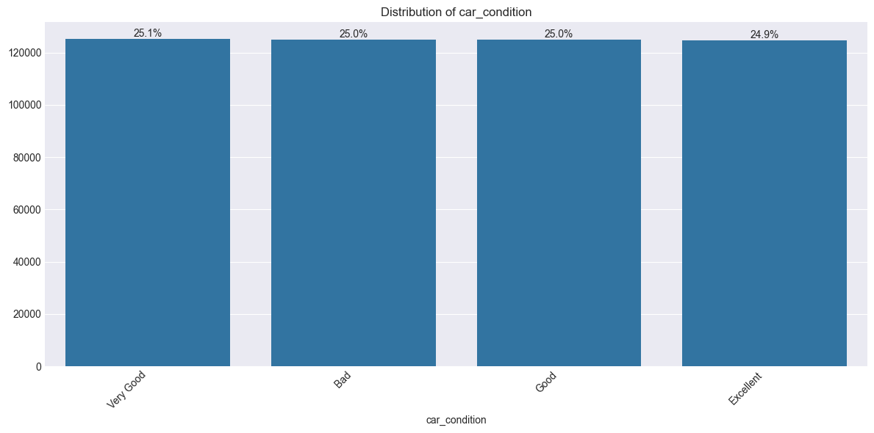
Data Insights

Slide 48
THANKS!
Do you have any questions?

